Slide 1
MISSION UPDATES

Slide 2
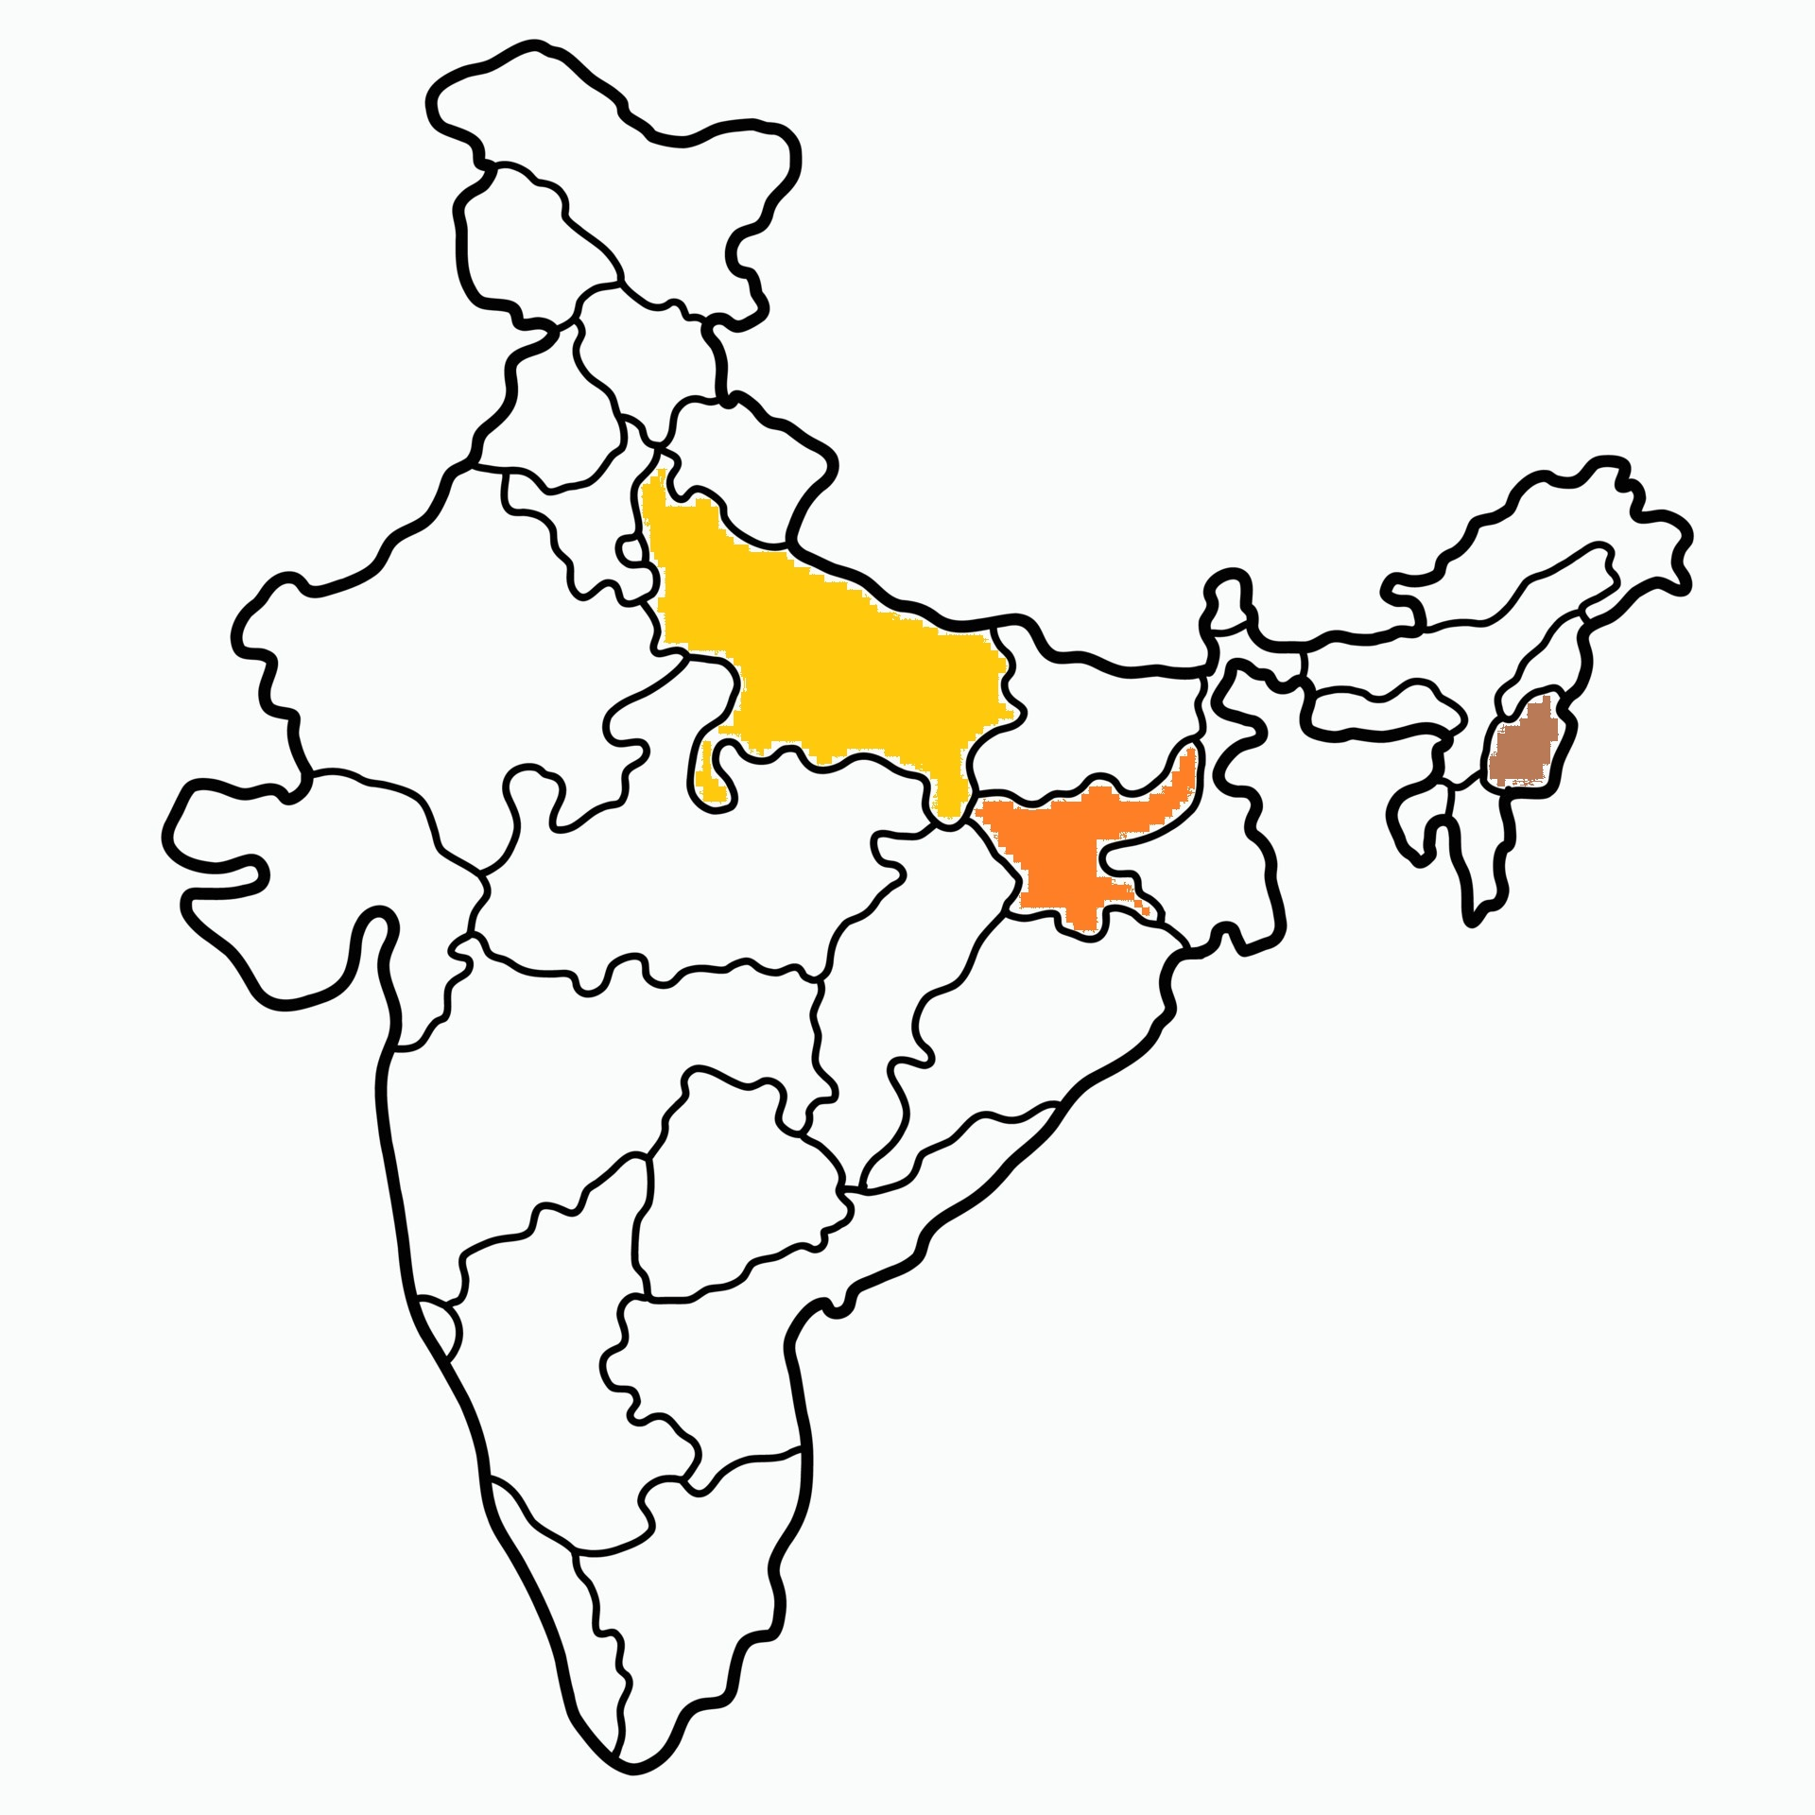

Slide 3
Mission Stations
10 mission stations supported in Jharkhand.
5 mission stations supported in U.P.
1 ICPF workstation supported in North-east India.

Slide 4
NORTH INDIA MISSION
UP
Pr. Sunny George
5 Stations
Jharkhand
Pr. Sam
10 Stations
ICPF
Dr. James George
1 Station

Slide 5
Jharkhand

Slide 6
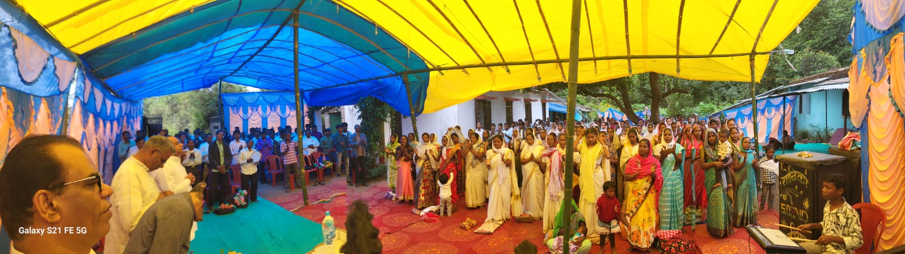
Convention
In Bano, Simdega.
42 people received Jesus as their Saviour.

Slide 7
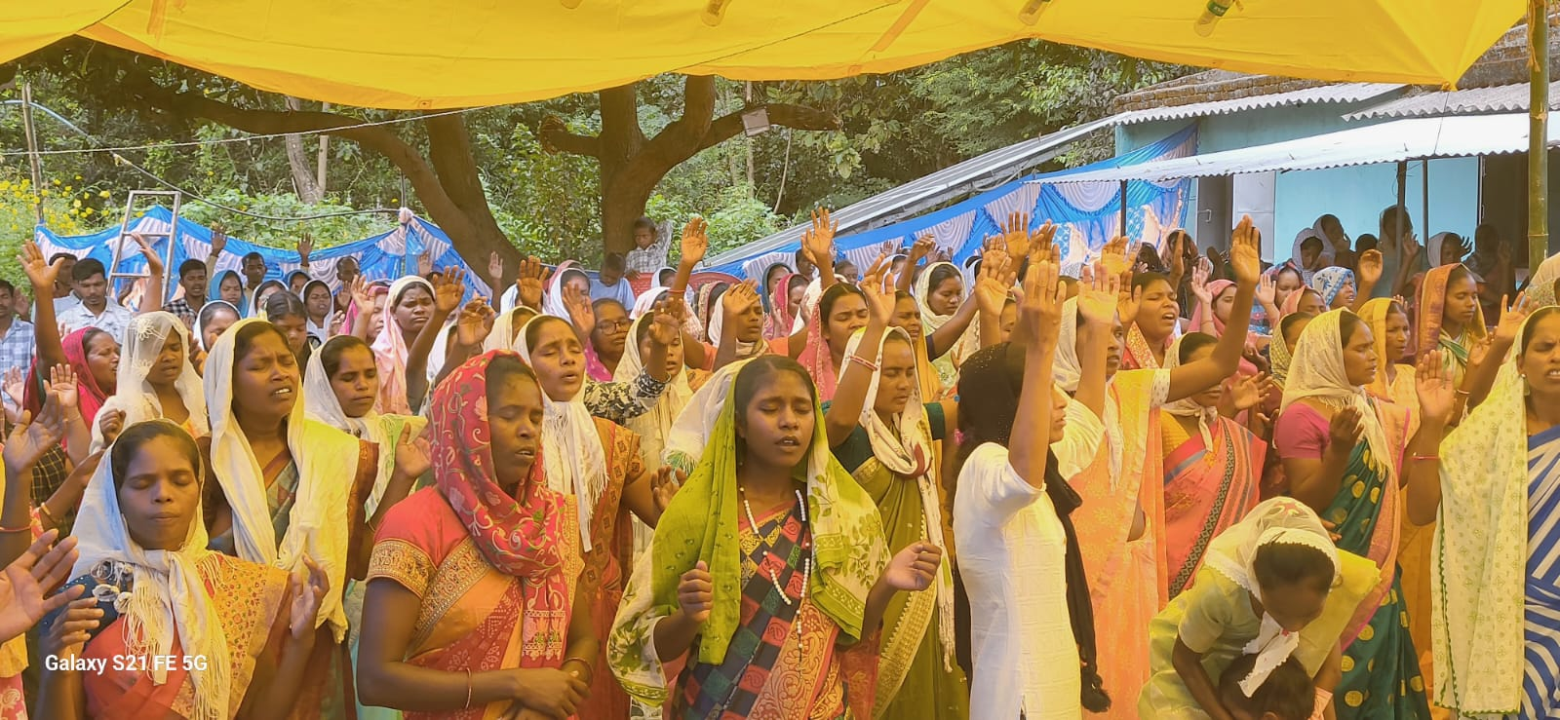

Slide 8
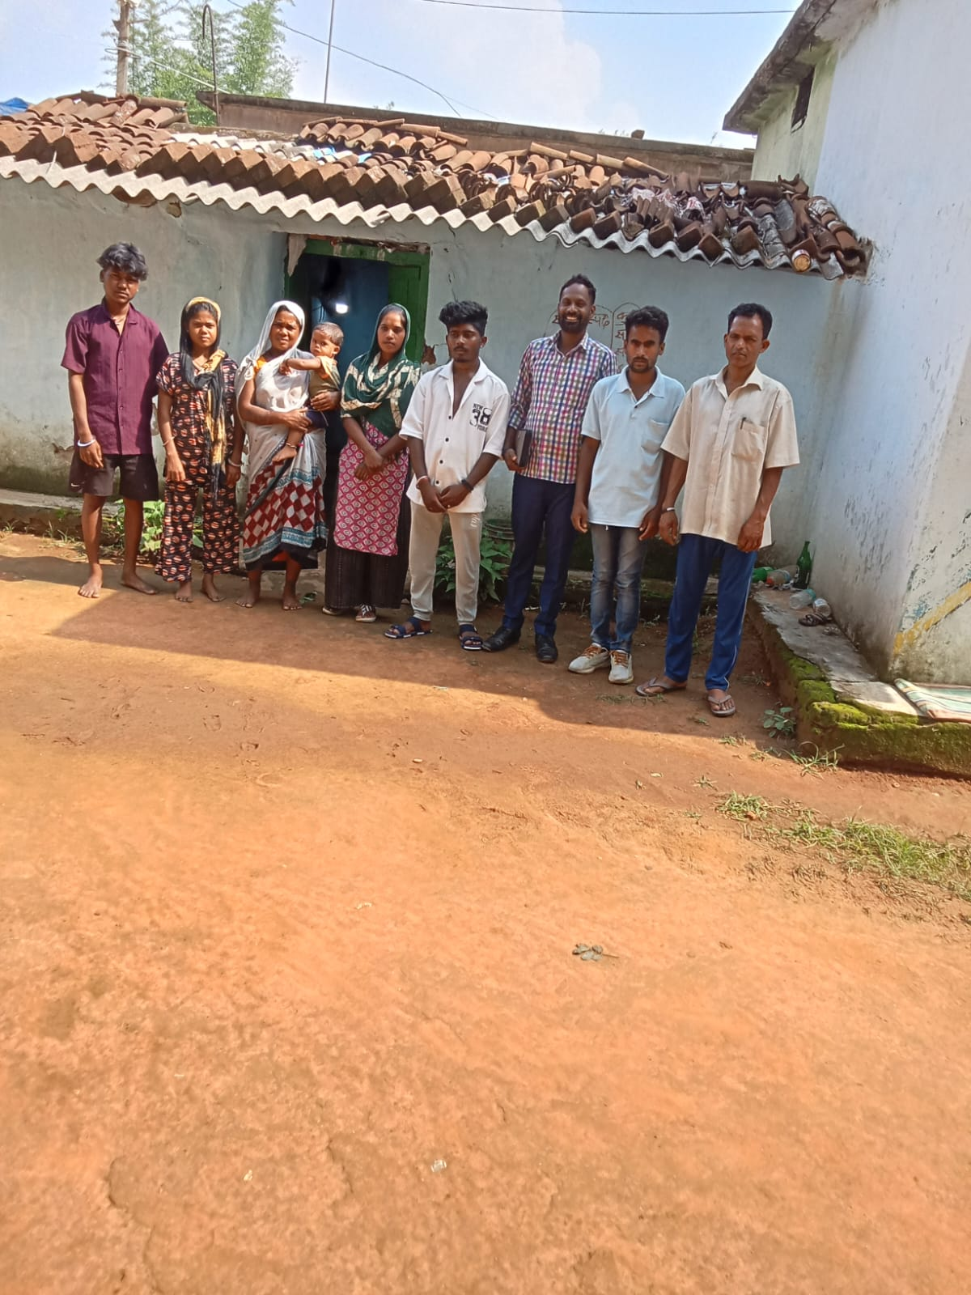
Gospel sharing in Village

Slide 9
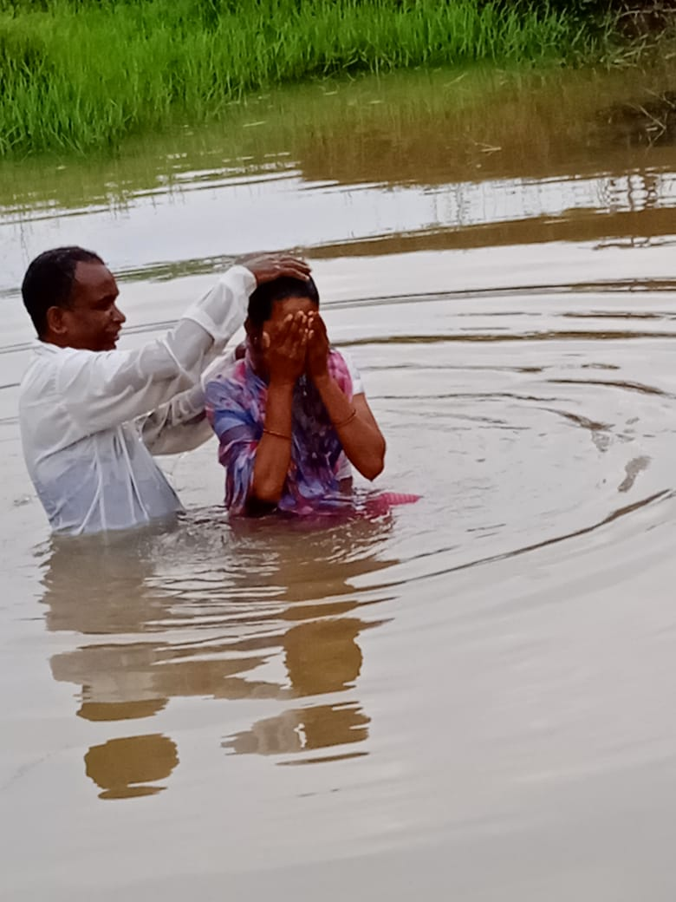
Baptism
6 people received Baptism this month.

Slide 10
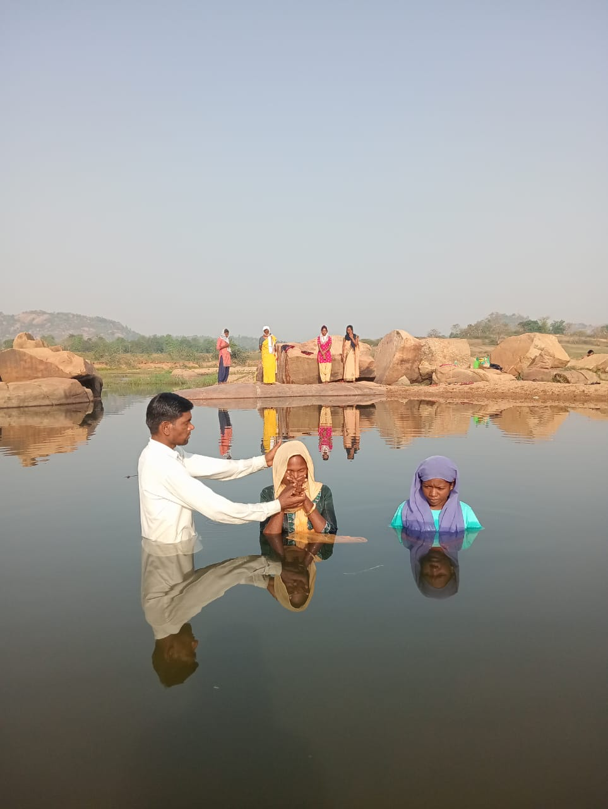

Slide 11
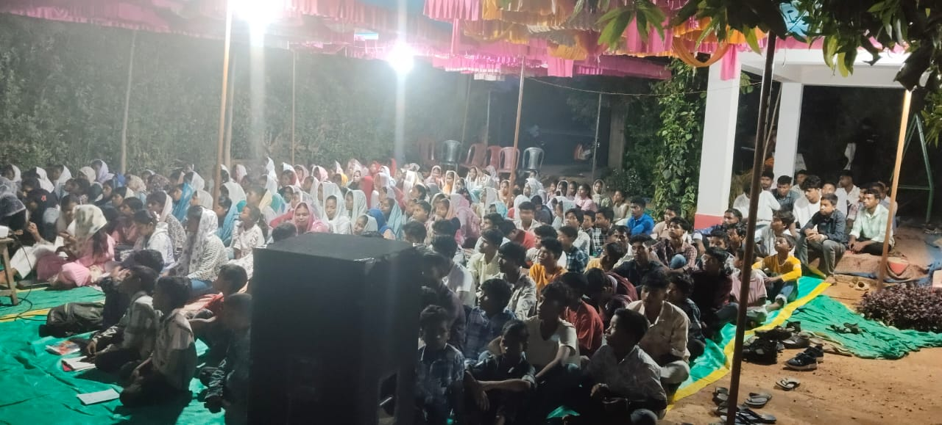
Youth meeting

Slide 12
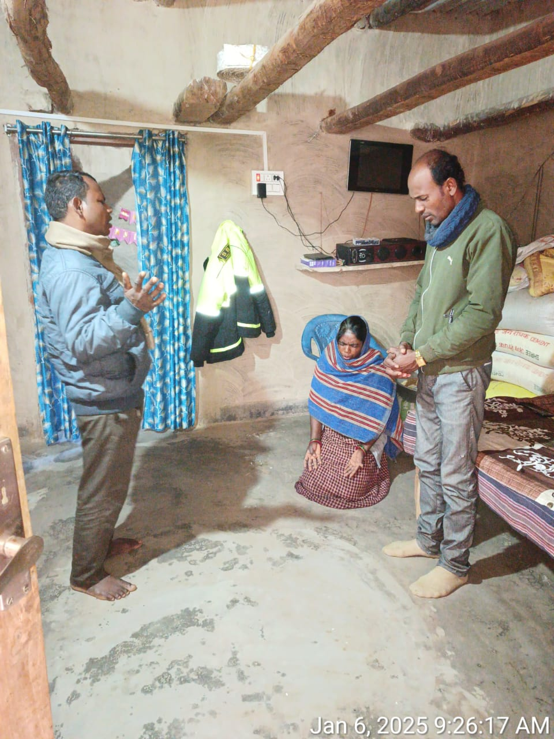
New family added to Church

Slide 13
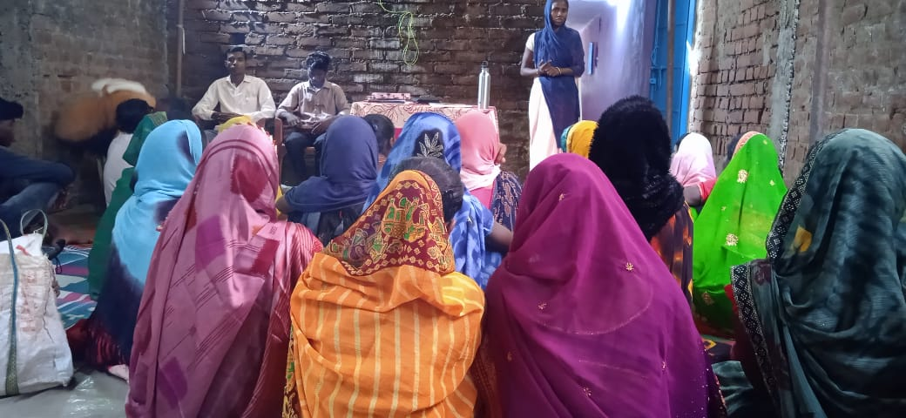
Fasting Prayer

Slide 14
Church In Pahan Toli, Simdega

Slide 15
Church In Banki Munda Toli

Slide 16
Church In Sode

Slide 17
Church In Kenduda

Slide 18
Church In Ushram, Rania

Slide 19
Church In Ramanuganj

Slide 20
Church In Bargarh

Slide 21
Church In Torppa

Slide 22
Thank You

